Slide 1



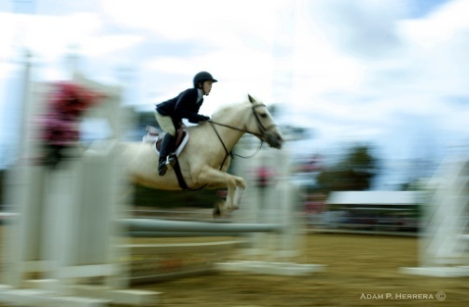
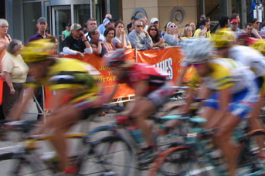

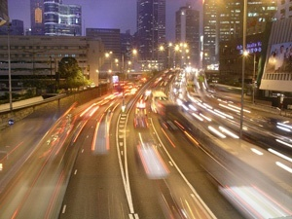
Motion from Blur
NORTHWESTERN
UNIVERSITY
Shengyang Dai and Ying Wu
EECS Department, Northwestern University

Slide 2
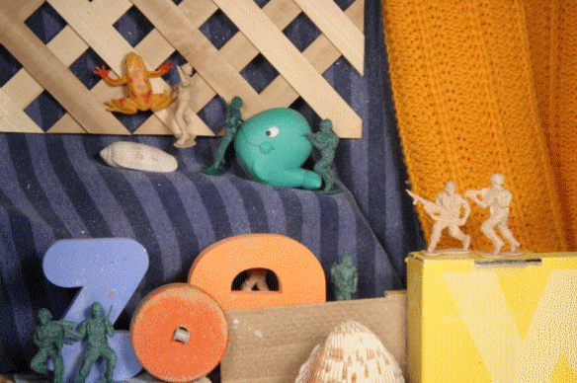
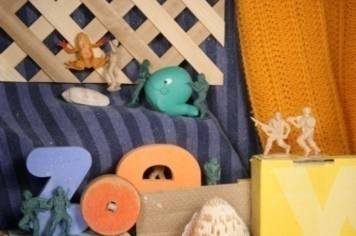


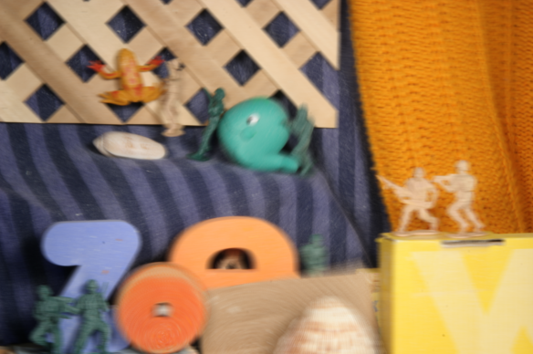
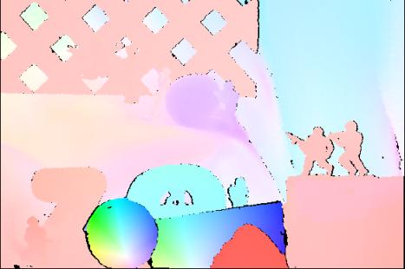

Discrete samples over time
Integral over time
Optical flow estimation
Motion from blur
?
http://vision.middlebury.edu/flow/
Baker, Scharstein, Lewis, Roth, Black, Szeliski, ICCV’07
(courtesy to Simon Baker)
Notes:
Motion is a fundamental problem, optical flow is one way to estimate motion from image pair / sequence
image pair / sequence sample 3D video cube at discretized time point. Blurred image is an integral over the time domain. They are two different observations of the 3D continuous video cube
A close-up view of an image patch to better visualize the difference of the two kinds of observations.
It is obvious that the blurred image retains a lot of motion informations, a natural question …

Slide 3
Literature
 | Task | Input | Extra info
Q. Shan, W. Xiong, and J. Jia, CVPR 07 | Rotational motion blur | Single image | User interaction
A. Levin, NIPS 06 | Multiple / local invariant linear motion estimation and segmentation |  | Known single blur direction
S. Cho, Y. Matsushita, and S. Lee, ICCV 07 |  | Two images | X
L. Bar, B. Berkels, M. Rumpf, and G. Sapiro, ICCV 07 |  | Sequence
Space-variant linear motion estimation from blurred image(s)
Notes:
In this work, we are focused only on the linear motion blur, where the blur kernel is a line segment, and could be space-variant.
For the problem of estimating **space-variant linear motion blur** based on **observation of blurred image**, existing works usually address a specific case, such as rotation, or,
The input could be 1 or multiple, and sometimes, extra information is needed to…
There are also several methods try to extract motion with different observation, such as non-blurred image, which can be considered as using different observation.

Slide 4
Our work
 | Task | Input | Extra info
Q. Shan, W. Xiong, and J. Jia, CVPR 07 | Rotational motion blur | Single image | User interaction
A. Levin, NIPS 06 | Multiple / local invariant linear motion estimation and segmentation |  | Known single blur direction
S. Cho, Y. Matsushita, and S. Lee, ICCV 07 |  | Two images | X
L. Bar, B. Berkels, M. Rumpf, and G. Sapiro, ICCV 07 |  | Sequence
Our work
1. Global parametric form motion from blur (e.g., affine / rotational motion)
2. Multiple / local motion estima-tion and segmentation from blur
3. Non-parametric motion from blur
Single image
X
Space-variant linear motion estimation from blurred image(s)

Slide 5

+
-
Notes:
Define notation b: to represent the motion blur vector
Please notice that b and –b are actually equivalent, since blurred image do not give time information, the motion could be in either direction.
Now we consider …, it is interesting to notice that the result will be the difference of convolving the non-blurred image with two blur kernel, after removing the overlapping region of blur kernels, we end up with a difference of two positions of the non-blurred image. Thus we can get the following equation. We call it motion blur constraint.

Slide 6

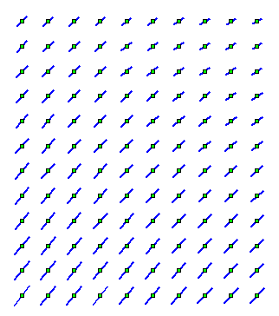
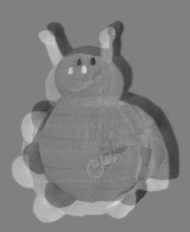

Motion blur constraint
( ) ·
=
Notes:
Now we use a simple example to further illustrate the meaning of this constraint.
The result is a pattern shows the difference of two shifted version of the original non-blurred image, the shifting vectors are half of the motion blur vector on two opposite directions.

Slide 7
Motion Blur vs. Optic Flow
?
Lucas and Kanade, 81
Horn and Schunck, 81
Barron, Fleet, Beauchemin, IJCV 94
Black and Anandan, CVIU 96
Baker and Matthews, IJCV 04
Baker, Scharstein, Lewis, Roth, Black, Szeliski, ICCV 07
……
Notes:
Compare flow equation with blur constraint side by side
Extensive work for flow, could be potentially applied on blur?
It is difficult,
However, RHS is still unknown

Slide 8










channel image representation
Spectral matting
Levin, Rav-Acha, and Lischinski, CVPR 07
Unsupervised image layer decomposition
0
1
(courtesy to Anat Levin)
Notes:
We propose to use alpha-channel image representation to further simplify this unknown.
With the recently proposed spectral matting method, the input image can be decomposed as a combination of multiple layers through the alpha channel automaticially.
The corresponding alpha channels are shown here. The alpha-c representation means that we use those alpha values to represent the image, instead of the original image colors.
Although the range of the alpha value is between 0 and 1, most of the resulting alpha value are in fact very close to 0 or 1 in a non-blurred image. It is reasonable, since without motion blur, the images captured by current cameras are mostly have clear and sharp edge transitions, which corresponding to binary alpha values. (except for some special effects)
Since mixture contribution of multiple image layers mostly exist on region boundaries, thus only take a small portion of the input image.

Slide 9
Alpha motion blur constraint
Use to replace the original image
  Assumptions: most pixels have 0 / 1 alpha values
  Observation: mostly when
Notes:
Show the derivation of the alpha motion blur constraint step-by-step
Define the binary free parameter

Slide 10
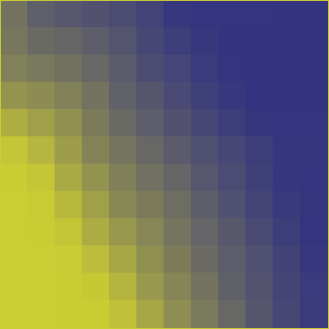
Alpha motion blur constraint
motion blurred image
Notes:
Here is an intuitive explanation of the alpha motion blur constraint
Let is take a look of a motion blurred image edge.

Slide 11

Alpha motion blur constraint
1
0
Alpha channel of the blurred image
Notes:
With alpha decomposition, edge is normalized
Give the intuitive explain. (1) the projection of the blur vector on the alpha gradient is fixed, (2) The transition has a fixed value 0 to 1, so the blur extend is inversely proportional to the gradient magnitude, (3) +/-1 incorporate the direction ambiguity.
Aperture problem, similar to flow

Slide 12
Motion Blur vs. Optic Flow
?
Lucas and Kanade, 81
Horn and Schunck, 81
Barron, Fleet, Beauchemin, IJCV 94
Black and Anandan, CVIU 96
Baker and Matthews, IJCV 04
Baker, Scharstein, Lewis, Roth, Black, Szeliski, ICCV 07
……
Notes:
Recall the previously mentioned difficulty
Now flow algorithm can be applied
Binary free parameter brings some difficulty

Slide 13

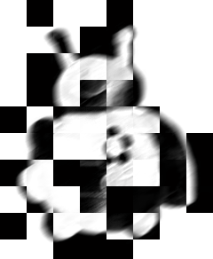
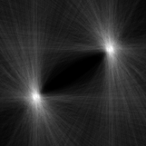
Hough transform
b
Notes:
Explain the sliding window alpha extraction method, due to computation reason
How to apply the alpha blur constraint for a space-invariant case by simple voting

Slide 14
Techniques for optical flow
Lucas-Kanade
Horn-Schunck
Robust estimation
RANSAC
Multiple resolution
Parametric
Piecewise smooth
Segmentation
LK meets HS
……

Slide 15
Techniques for motion from blur
Lucas-Kanade
Horn-Schunck
Robust estimation
RANSAC
Multiple resolution
Parametric
Piecewise smooth
Segmentation
LK meets HS
……
Notes:
Techniques we actually used so far.

Slide 16
Tasks

Slide 17


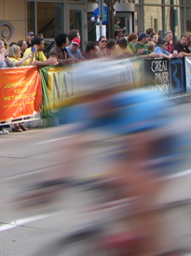

Global affine motion blur
Global rotational motion blur
Non-parametric motion
field estimation
Multiple blur model estimation
and segmentation

Slide 18
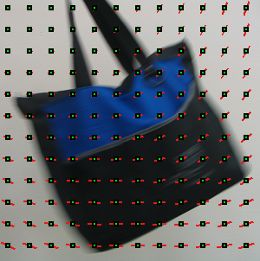

Experiments – affine motion

Slide 19
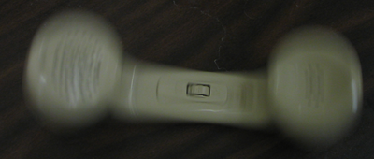
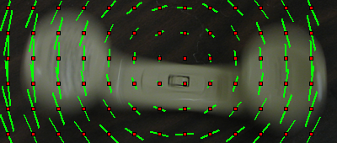
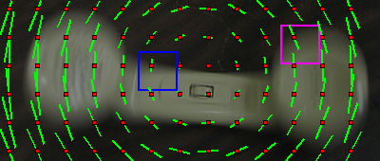
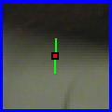
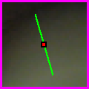
Experiments – rotational motion
Notes:
Blur vector matches the blur extend

Slide 20
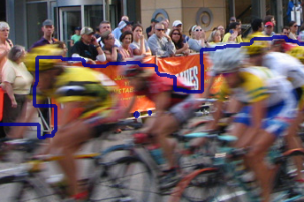
Experiments – segmentation
Segmentation result
Notes:
Show the extracted alpha description
The likelihood term is defined according to the fitting error of the blur constraint
Final result is obtained with MRF

Slide 21
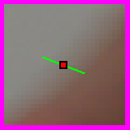

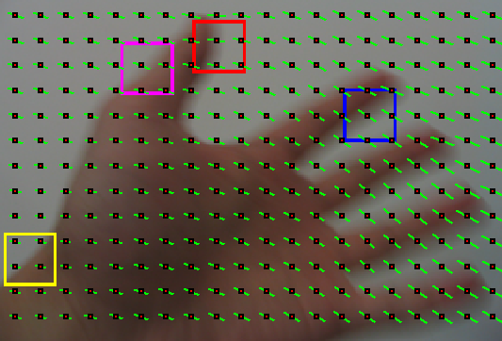
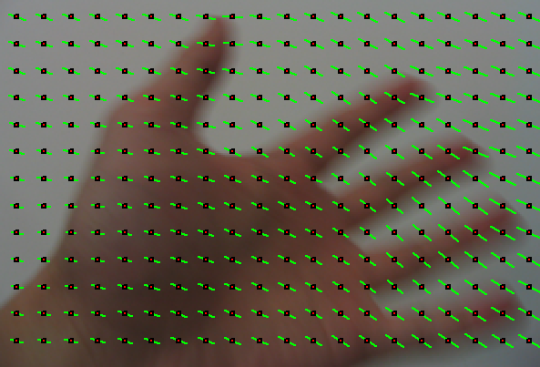
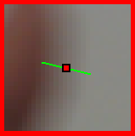
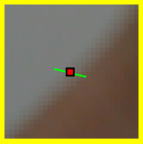
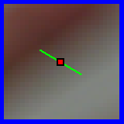
Experiments – non-parametric motion
Notes:
Initialized with a space-invariant blur, to estimate the binary free parameter
Update with iteration similar to HS method

Slide 22
Applications

Slide 23
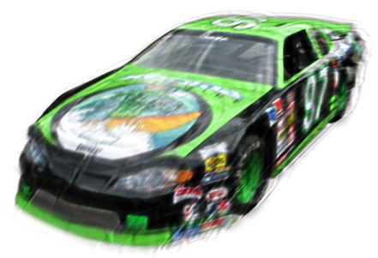


Image deblurring
Modified Richardson-Lucy iteration
Deblurred result (PSNR: 24.75dB)
Synthesized affine blurred image
(PSNR: 21.66dB)
average estimation error: 0.43
average motion vector: 15.43
Ground truth image

Slide 24
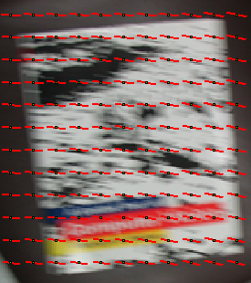

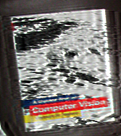
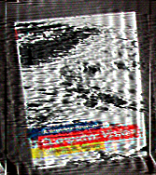
Affine blurred image
Our deblur result with
space-variant blur
modified RL iteration
Matlab deconvlucy with
space-invariant blur
original RL iteration

Slide 25



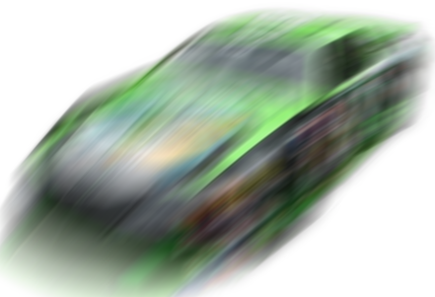
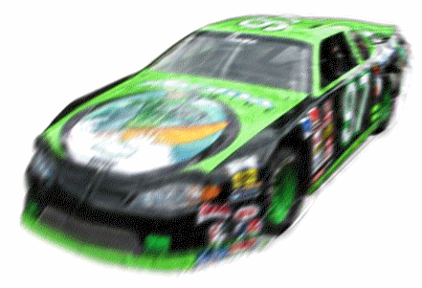

Blur / motion synthesis
time
Input
Deblurred
Blur synthesis
Motion synthesis
Notes:
Synthesization by different sampling / integral scheme

Slide 26

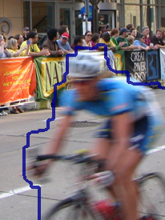

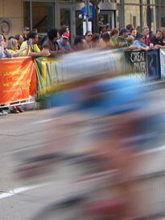
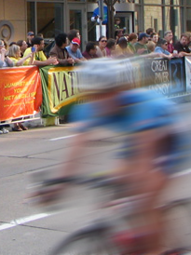
Blur synthesis

Slide 27
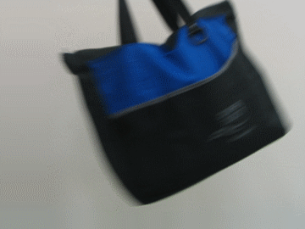
Motion synthesis
Input
Output

Slide 28
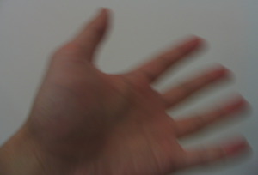
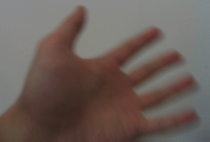
Motion synthesis
Input
Output

Slide 29
Summary
Contributions
  A local linear motion blur constraint
  Connection between motion blur and optic flow
  Space-variant motion estimation from blur
  Applications on deblurring and blur/motion synthesis
Limitations
  May not hold for heavily textured region
  Rely on robust matting
Future work
  Integrating more algorithms from optic flow
Notes:
At least two cases may not hold: 1) blur direction same as edge direction, 2) texture, or blur extend larger than object itself, it is totally blurred

Slide 30
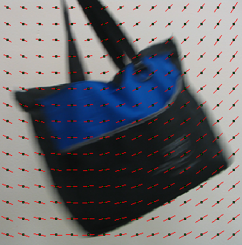



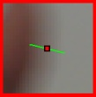
Motion from Blur
Shengyang Dai and Ying Wu
EECS Department, Northwestern University
Thanks! Questions?

